Slide 1
Philadelphia Code Camp
Making Drone Cars

Slide 2
Demo of the Car

Slide 3
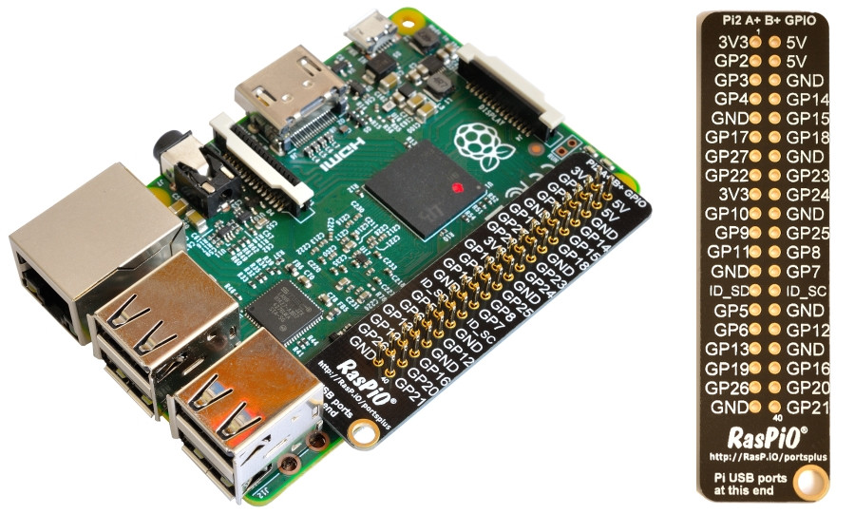
Raspberry Pi 3 Overview Specs
SoC: Broadcom BCM2837 CPU: 4× ARM Cortex-A53, 1.2GHz GPU: Broadcom VideoCore IV RAM: 1GB LPDDR2 (900 MHz) Networking: 10/100 Ethernet, 2.4GHz 802.11n wireless Bluetooth: Bluetooth 4.1 Classic, Bluetooth Low Energy Storage: microSD GPIO: 40-pin header, populated Ports: HDMI, 3.5mm analogue audio-video jack, 4× USB 2.0, Ethernet, Camera Serial Interface (CSI), Display Serial Interface (DSI)

Slide 4
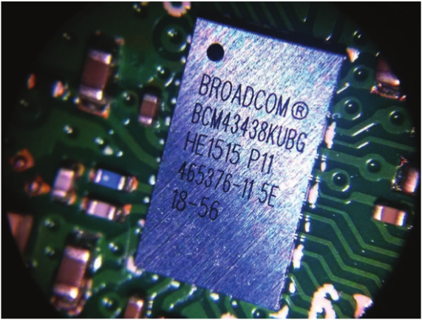
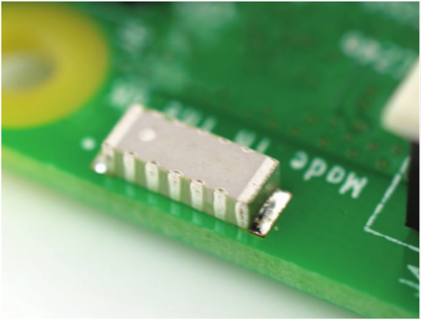
Wireless Hardware
Broadcom BCM43438 chip provides 2.4GHz 802.11n wireless LAN, Bluetooth Low Energy, and Bluetooth 4.1 Classic radio support
Antenna built on to board
No need for external antenna

Slide 5
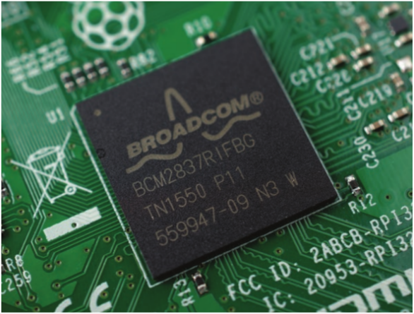
SoC – System on Chip
Broadcom BCM2837 system-on-chip (SoC)
4 ARM Cortex-A53 Processing Cores
Each Core 1.2GHz
32kB Level 1 Cache
512 kB Level 2 Cache
VideoCore IV Graphics Processor
(supports 4K)
1 GB LPDDR2 Memory on rear of board

Slide 6
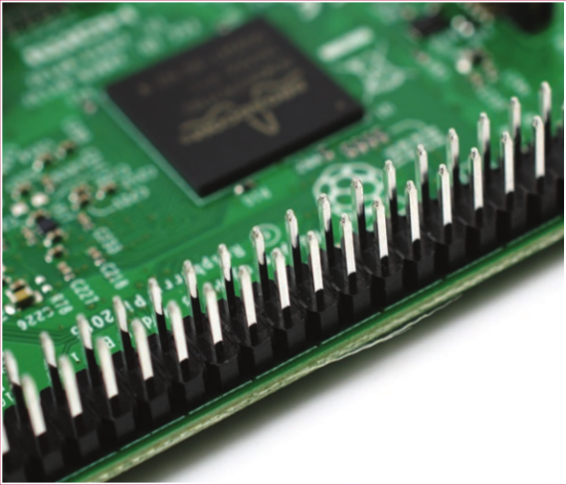
GPIO (General Purpose Input/Output)
40 GPIO Pins
With Following Configurations
3V3 | 3.3 volts | Anything connected to these pins will always get 3.3V of power
5V | 5 volts | Anything connected to these pins will always get 5V of power
GND | ground | Zero volts, used to complete a circuit
GP2 | GPIO pin 2 | These pins are for general-purpose use and can be configured as input or output pins

Slide 7
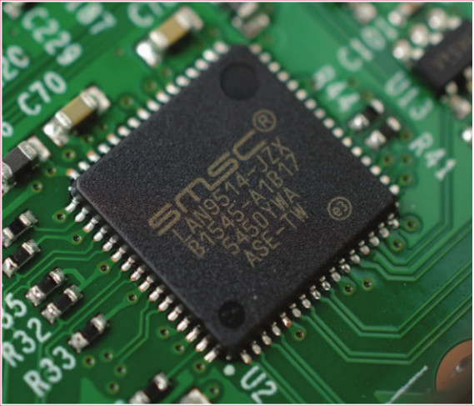
USB chip
4 USB Channels
SMSC chips to SoC via single USB Channel
Acts as USB-to-Ethernet Adapter
Acts as USB Hub

Slide 8
Software Install
Download Raspbian OS .zip folder
https://www.raspberrypi.org/downloads/raspbian/
Download SD Card Writer for Raspbian OS
https://sourceforge.net/projects/win32diskimager/
Download VNC Viewer
https://www.realvnc.com/download/viewer/
Download SSH Client
Putty/Git/Cmdr
Download Git for Laptop
https://git-scm.com/download/win

Slide 9
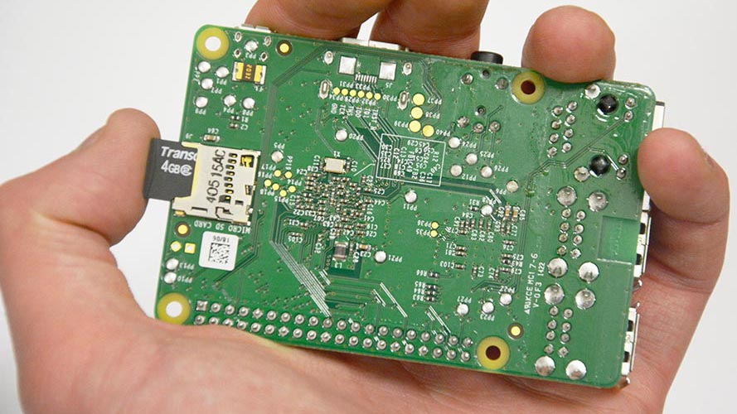
Install Raspbian OS
Put SD card into Laptop
Use Win32DiskImager
Write Raspbian OS to SD Card
Place SD Card into Raspberry Pi

Slide 10
Connect to Raspberry Pi
Connect Raspberry Pi to Monitor
Connect Keyboard and Mouse to Raspberry Pi
Connect Laptop to Wifi
Enable Internet Sharing on Laptop
Connect Ethernet Cord from Raspberry Pi to Laptop
Power On Raspberry Pi

Slide 11
Enable VNC Viewer and SSH
Go to menu in Raspberry Pi
Find Raspberry Config
Enable SSH
Enable VNC Viewer

Slide 12
SSH Testing from Laptop
Open up Terminal on Raspberry Pi
Type “ifconfig”
Write down ipaddress of raspberry pi in notepad on laptop
On laptop SSH into Raspberry Pi
ssh pi@<ip-address>
Password: raspberry
Disconnect from monitor

Slide 13
VNC Viewer Test
On Laptop
Launch VNC Viewer
Type in <ip-address-of-your-pi>
Username: pi
Password: Raspberry
Verify you can view your raspberry pi desktop

Slide 14
VNC Viewer Resolution Fix
SSH into Raspberry
ssh pi@<ip-address>
Password: raspberry
Type the following into terminal
cd boot
cp config.txt config.txt.bk
sudo nano config.txt
#uncomment lines framebuffer
Framebuffer 1280
Framebuffer 720
Log into Raspberry Pi via VNC Viewer
Disconnect from Monitor/Keyboard/Mouse

Slide 15
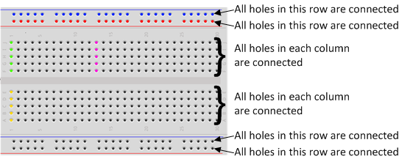
Breadboard Overview

Slide 16
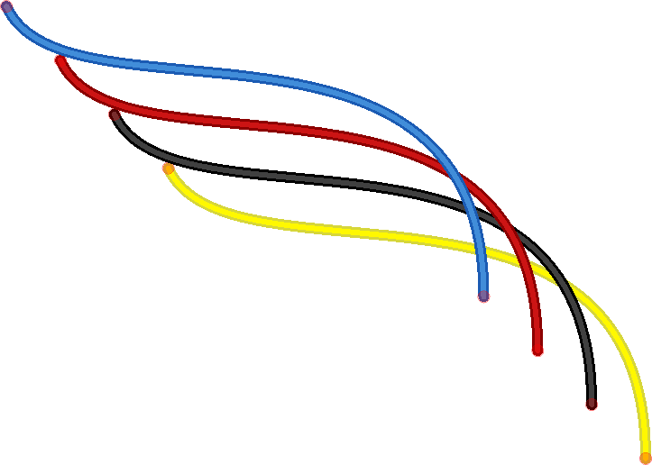
Jumper Cables Overview
Jumper wires are used on breadboards to ‘jump’ from one connection to another.
The ones you will be using in this circuit have different connectors on each end.
The end with the ‘pin’ will go into the Breadboard. The end with the piece of plastic with a hole in it will go onto the Raspberry Pi’s GPIO pins.

Slide 17

LED Overview
LED stands for Light Emitting Diode
Longer leg (known as the ‘anode’), is always connected to the positive supply of the circuit.
The shorter leg (known as the ‘cathode’) is connected to the negative side of the power supply, known as ‘ground’.

Slide 18
The Resistor
ALWAYS use resistors to connect LEDs up to the GPIO pins of the Raspberry Pi.
The Raspberry Pi can only supply a small current (about 60mA).
The LEDs will want to draw more, and if allowed to they will burn out the Raspberry Pi.
Therefore putting the resistors in the circuit will ensure that only this small current will flow and the Pi will not be damaged.
Resistors are a way of limiting the amount of electricity going through a circuit; specifically, they limit the amount of ‘current’ that is allowed to flow.
Measures of resistance is called the Ohm (Ω), and the larger the resistance, the more it limits the current.
The value of a resistor is marked with coloured bands along the length of the resistor body.

Slide 19
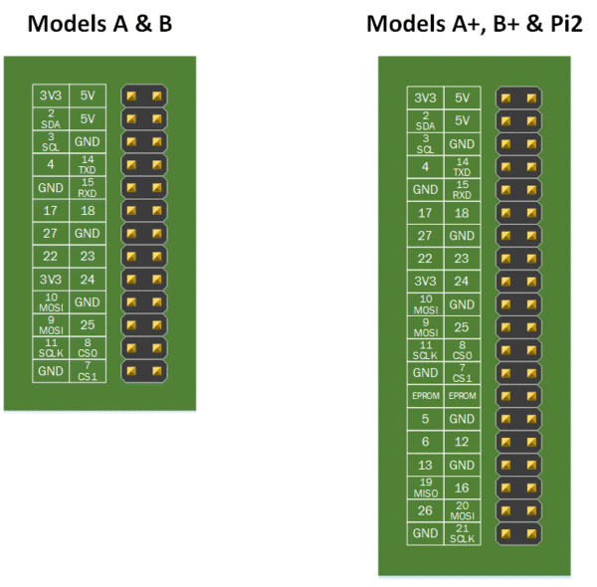
GPIO Pins
GPIO stands for General Purpose Input Output.
It is a way the Raspberry Pi can control and monitor the outside world by being connected to electronic circuits.

Slide 20
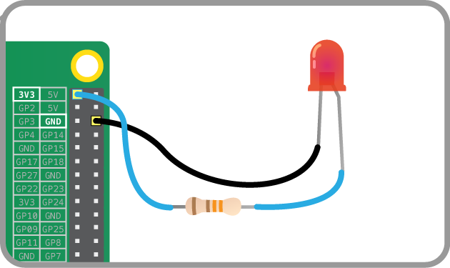
Turning on the Lights: Demo
Try connecting the long leg of an LED to the Pi's 3V3 and the short leg to a GND pin.
Use the 330Ω Resistor
Constant light no programming needed

Slide 21
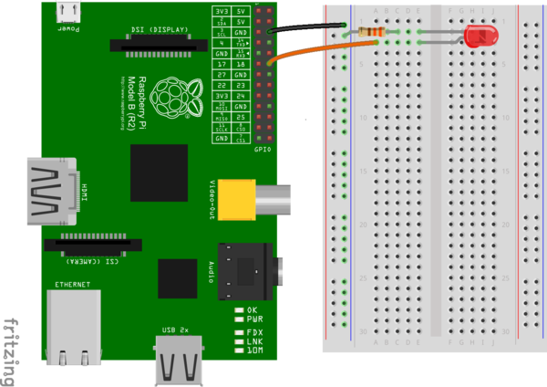
LED Walkthrough
Using Breadboard
Ground the 330Ω Resistor
Connect LED ‘anode’ to GPIO port 17
Connect LED ‘catode’ to 330Ω Resistor which is grounded

Slide 22
Python: Code
import RPi.GPIO as GPIO import time
GPIO.setmode(GPIO.BCM) GPIO.setwarnings(False) GPIO.setup(17,GPIO.OUT) print "LED on" GPIO.output(17,GPIO.HIGH) time.sleep(1) print "LED off" GPIO.output(17,GPIO.LOW)
Open IDLE Python 3
Save led.py to Desktop

Slide 23
import RPi.GPIO as GPIO | The first line tells the Python interpreter (the thing that runs the Python code) that it will be using a ‘library’ that will tell it how to work with the Raspberry Pi’s GPIO pins. A ‘library’ gives a programming language extra commands that can be used to do something different that it previously did not know how to do. This is like adding a new channel to your TV so you can watch something different.
import time | Imports the Time library so that we can pause the script later on.
GPIO.setmode(GPIO.BCM) | Each pin on the Pi has several different names, so you need to tell the program which naming convention is to be used.
GPIO.setwarnings(False) | This tells Python not to print GPIO warning messages to the screen.
GPIO.setup(17,GPIO.OUT) | This line tells the Python interpreter that pin 18 is going to be used for outputting information, which means you are going to be able to turn the pin ‘on’ and ‘off’.
print "LED on" | This line prints some information to the terminal.
GPIO.output(17,GPIO.HIGH) | This turns the GPIO pin ‘on’. What this actually means is that the pin is made to provide power of 3.3volts. This is enough to turn the LED in our circuit on.
time.sleep(1) | Pauses the Python program for 1 second
print "LED off" | This line prints some information to the terminal.
GPIO.output(17,GPIO.LOW) | This turns the GPIO pin ‘off’, meaning that the pin is no longer supplying any power.

Slide 24
Flashing LED - Exercise
Open IDLE Python 3
Save Flashing_LED.py
Can you make your LED Flash on/off every second?

Slide 25
Turn On Multiple LED’s Exercise
Can you turn on three LED’s at once?
Can you make the color blue (hint red + yellow)?
Can you flash red, yellow, green in this order?

Slide 26
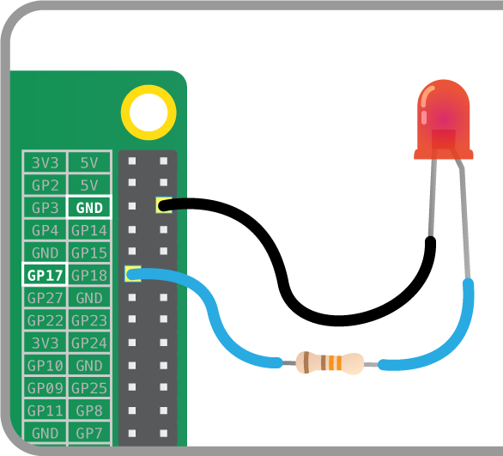
LED GPIOZero Library
GPIO Pin 17
Ground
Connect LED ‘catode’ to 330Ω Resistor which is grounded

Slide 27
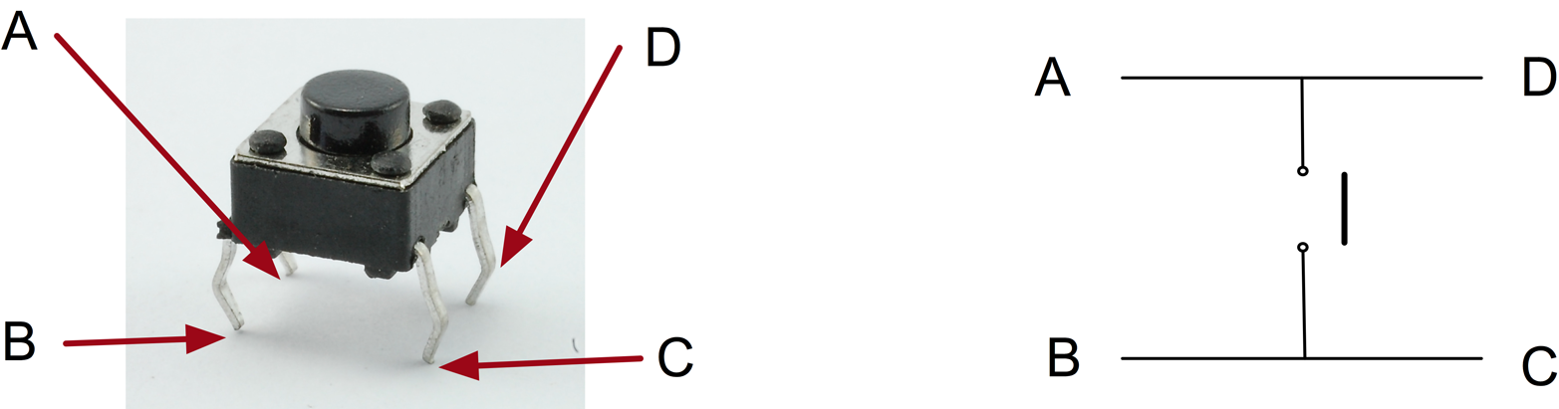
Tactile Button Review
You might expect the push switch to have just two connections, which are either open or closed.
While some of these tactile push switches do have just two connections, most have four. shows how these connections are arranged.

Slide 28
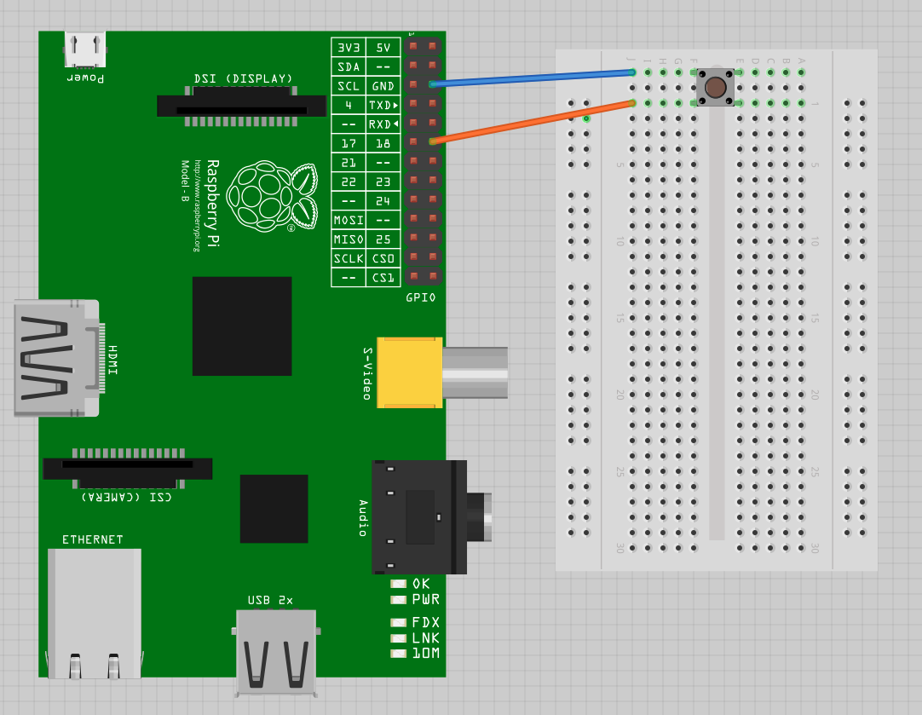
Button Demo: ‘Press Me’
GPIO Pin 2
Ground
When you press the button python says: “Press Me”

Slide 29
Light Switch with a Button: Demo
LED
Ground the 330Ω Resistor
Connect LED ‘anode’ to GPIO pin 17
Connect LED ‘catode’ to 330Ω Resistor which is grounded
Button
GPIO pin 2
Ground Button

Slide 30
Demo: GPIOZero Library
Button
GPIO pin 2
Ground Button
Using GPIOZero Library

Slide 31
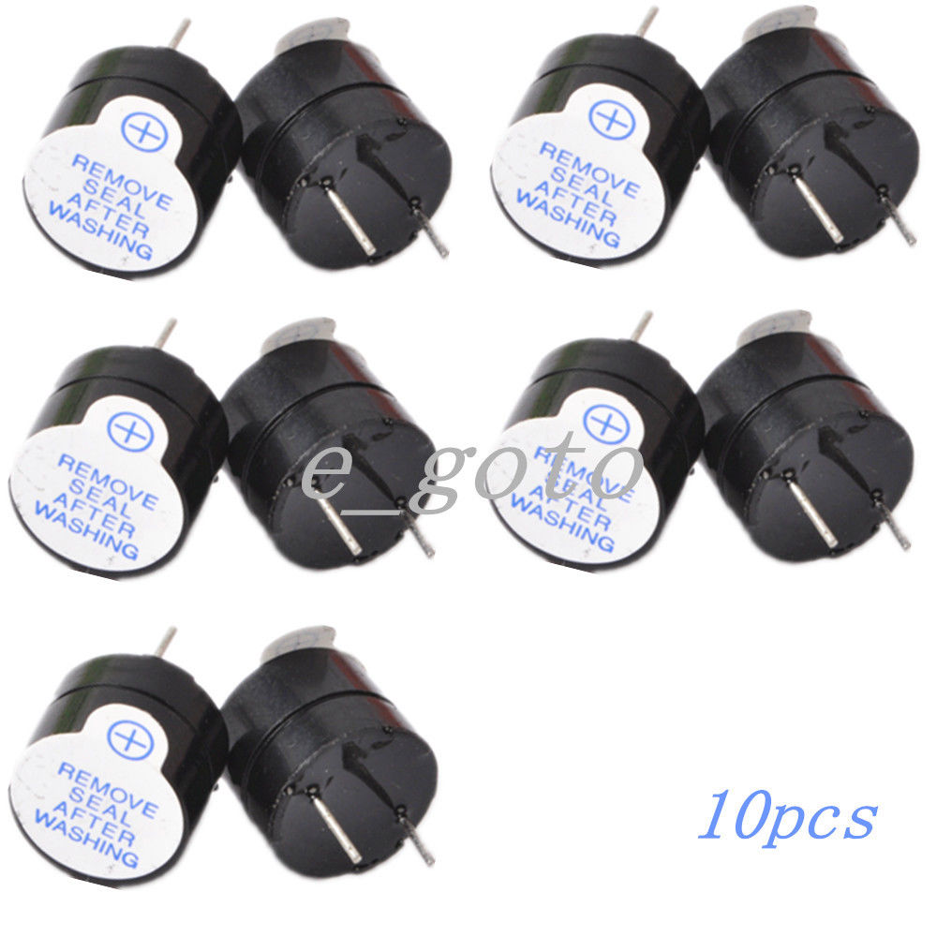
Buzzer Overview
Passive Buzzers
emits a tone when a voltage is applied across it.
requires a specific signal to generate a variety of tones
Active Buzzers
are a lot simpler to use
can be connected just like a LED

Slide 32
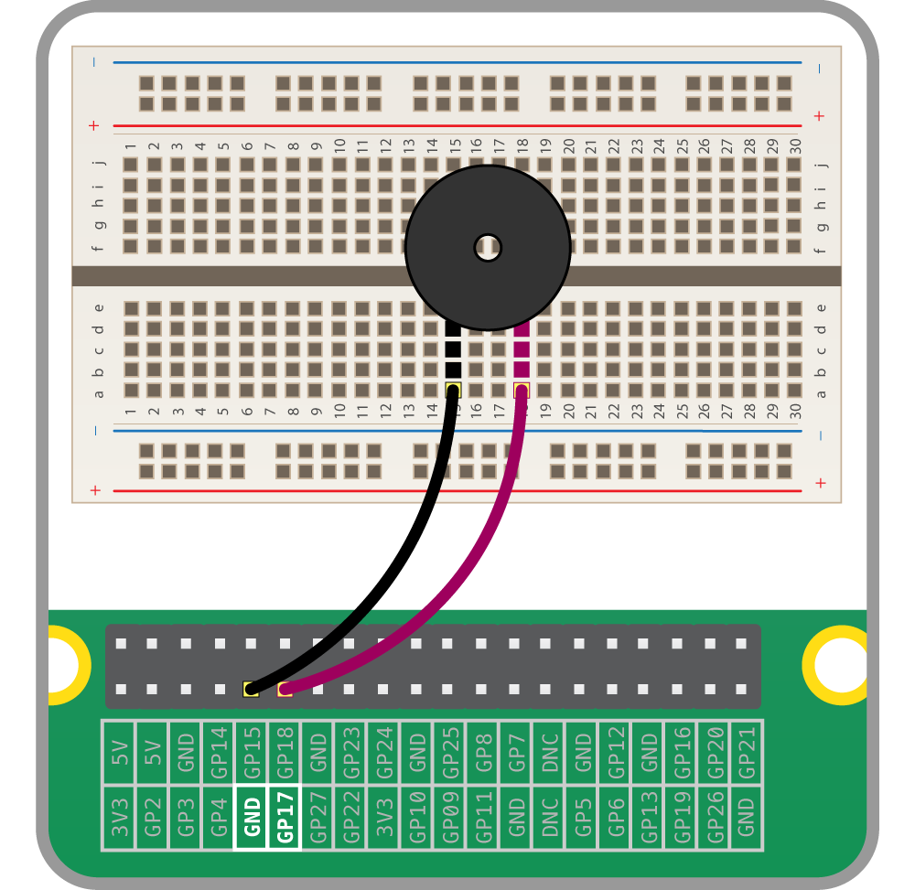
Buzzer Exercise
Buzzer
GPIO pin 17
GPIO pin Ground
Hint no need for resistors
Can you make your buzzer make buzz?

Slide 33
Demo: GPIOZero Buzzer Library
Button
GPIO pin 17
Ground Button
Using GPIOZero Library

Slide 34
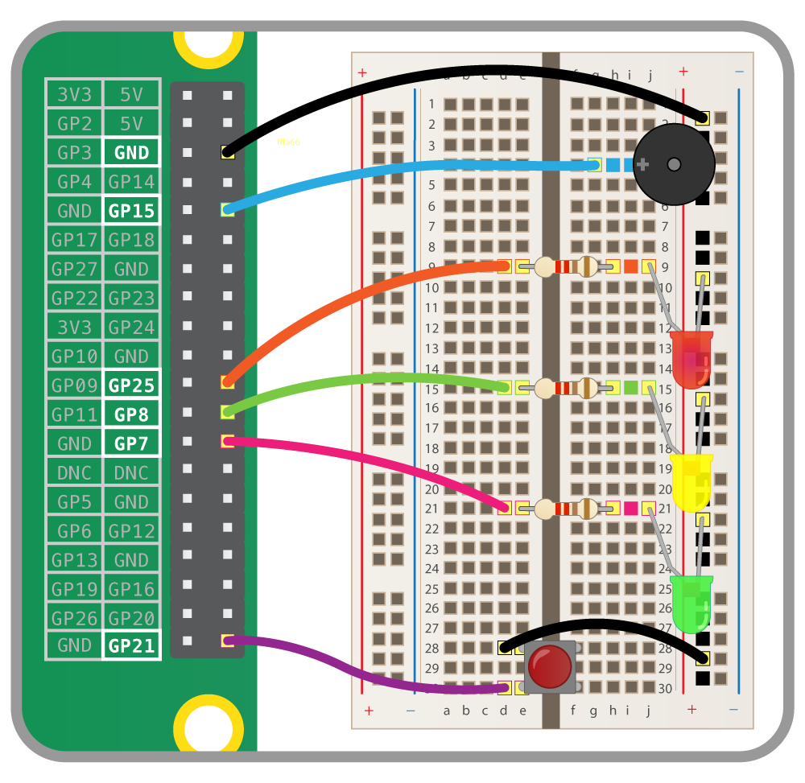
Traffic Lights Exercise
Component | GPIO pin
Button | 21
Red LED | 25
Amber LED | 8
Green LED | 7
Buzzer | 15

Slide 35
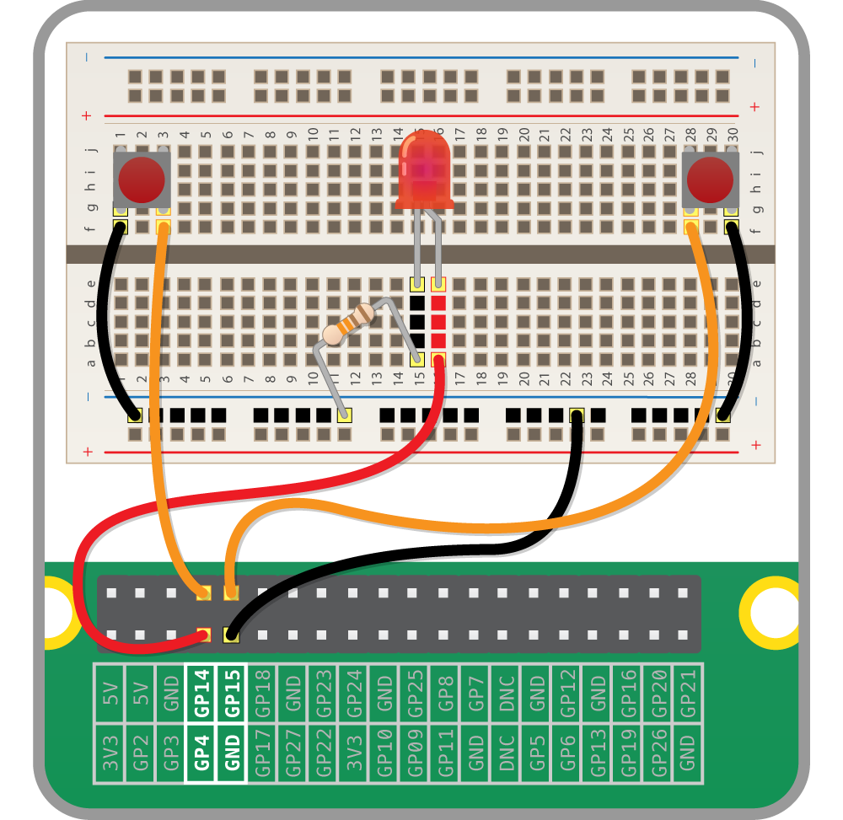
Reaction Game
Component | GPIO pin
Button | 15
Button | 14
LED | 14

Slide 36
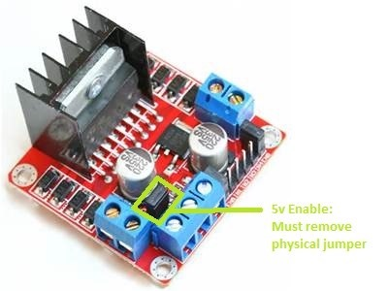
L298N
The L298N motor driver allows you to spin the motors forwards AND backwards using a handful of GPIO pins

Slide 37
Link Power to Raspberry Pi
We are setting up the L298N, we’ll go ahead and link the power from the Raspberry Pi to the L298N.
First, remove the physical jumper – labeled ‘5v enable’ in the photo – from the L298N.
This sets the motor controller logic to be powered by the Raspberry Pi via the +5v terminal on the power block rather than from the power source connected to the +12v terminal.

Slide 38
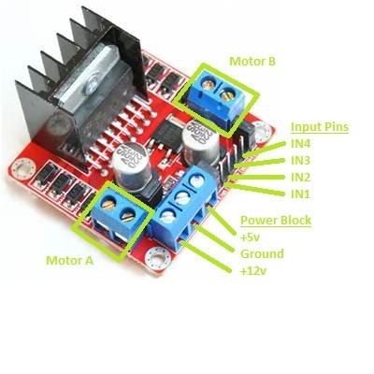
GPIO Ports
IN1 -> GPIO 27 / physical 13
IN2 -> GPIO 22 / physical 15
IN3 -> GPIO 5 / physical 29
IN4 -> GPIO 6 / physical 31

Slide 39
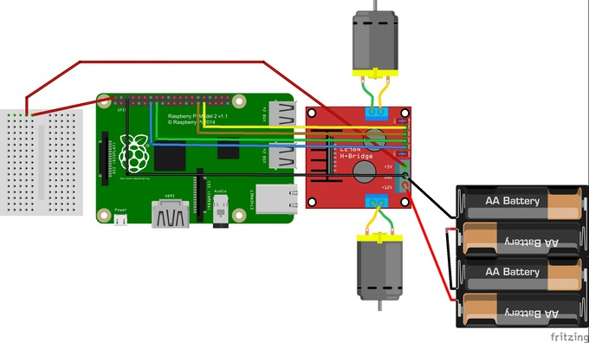
Build Overview

Slide 40
Keyboard Drone
Manual Control Drone via SSH/Terminal

Slide 41
Pokemon Go Drone Car
Automate a path for your via Code

Slide 42
Adding Eyes to Drone Car
Follow ReadMe.txt in Lesson 6
This will depend on each person’s camera they purchased

Slide 43
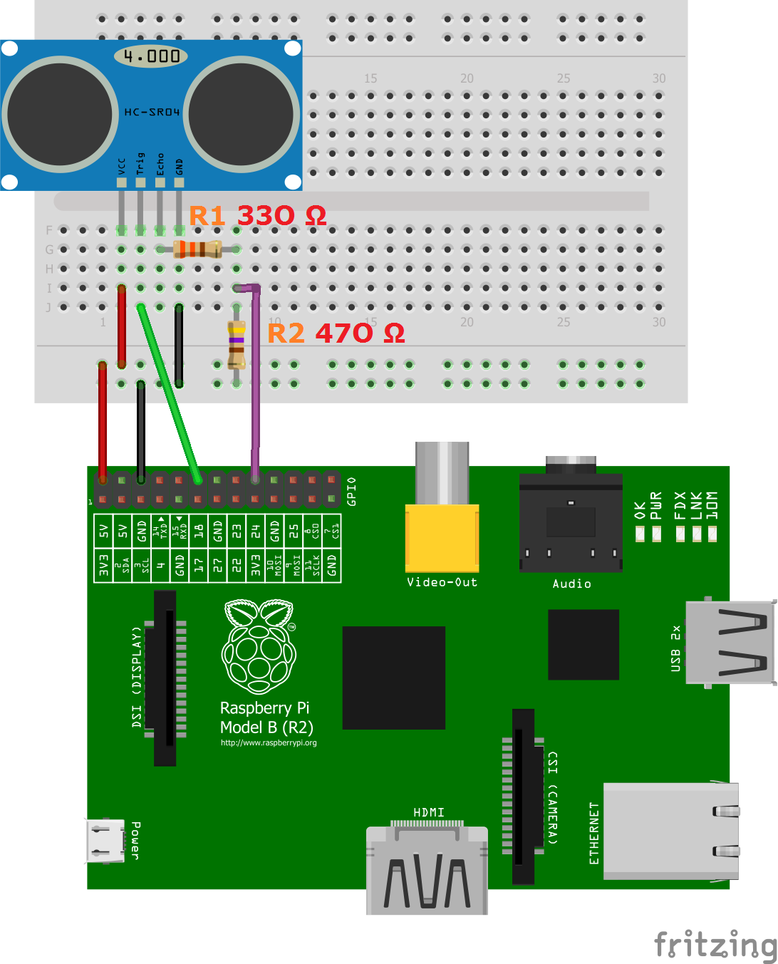
Adding Sonar Sensor
Here we will attach the sonar sensor to the raspberry pi
We need to use 330 resistor
We need to use 430 – 470 resistor
sonar-drone.py

